Slide 1
COMPUTER ORGANIZATION AND ASSEMBLY LANGUAGE (COA)
PRESENTATION TITLE :
SIGNED VS UNSIGNED MULTIPLICATION
PRESENTED BY: PRESENTED TO :
Muhammad Junaid MR. H. M. FAISAL
Tayyab Tahir
Aimen

Slide 2


Slide 3
Contents
Why multiplication is difficulty from other arithematic operations ?
Use of MUL and IMUL
Related examples
Related Approach

Slide 4
Multiplication Instructions (cntd…)
Multiplication is more complicated than the addition and subtraction operations for two reasons:
First, multiplication produces double-length results:
multiplication of two 8-bit numbers requires 16 bits to store the result
multiplication of two 16-bit numbers requires 32 bits to store the result
multiplication of two 32-bit numbers requires 64 bits for the result.
Second, multiplication of signed numbers should be treated differently from that of unsigned numbers, because signed result depends on the sign of the operands.

Slide 5
Multiplication Instruction
MUL Instructions
The MUL (Multiply) instruction handles unsigned data.
It Multiply 8-,16-,32- bits operands by either AL,AX register.
Syntax → MUL source(multiplier)
IMUL Instructions
IMUL (Integer Multiply) instruction handles signed data.
It multiplies two signed operands and stores the result in a 16 or 32-bit register, depending on the size of the operands.
Syntax → IMUL source(multiplier)

Slide 6
Unsigned Instructions (MUL)
To perform unsigned multiplication, you can use the "MUL" instruction, which multiplies two unsigned operands and stores the result in a 16 or 32-bit register, depending on the size of the operands.
The instruction formats are:
MUL r/m8
MUL r/m16
MUL r/m32

Slide 7
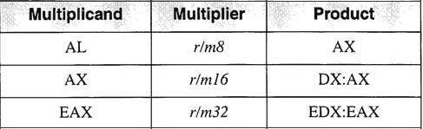
The following table shows the default multiplicand and product, depending on the size of the multiplier:
Multiplicand × Multiplier = Product
3 * 6 = +18
multiplicand
multiplier
product

Slide 8
MUL EXAMPLE
Mov 5h ,AL
Mov 10h,BL
MUL BL
Result
AX=0050h (as by default it is stored in AX reg)

Slide 9
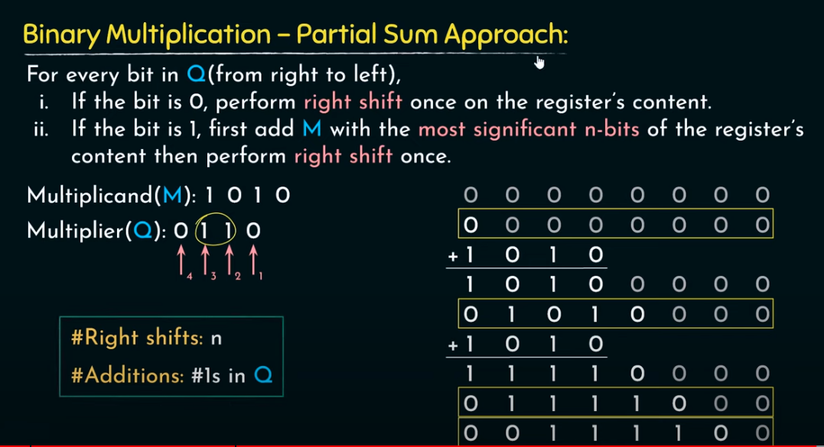
Another approach

Slide 10
Examples for practice
No#01
NO#02
What's the multiplication of Two unsigned 4 bit Integers yielding an 8 –bit Result ?
→ 1011 x 1101=…?
What's the multiplication of Two unsigned 4 bit Integers yielding an 8 –bit Result ?
→ 1001 x 0011= … ?

Slide 11
Signed Instructions
To perform signed multiplication, you can use the "IMUL" instruction, which multiplies two signed operands and stores the result in a 16 or 32-bit register, depending on the size of the operands.
The format is similar to Mul instructions
Syntax : IMUL Multiplier(source)
Note that when using the IMUL instruction, the sign extension of the operands is important. In general, you should use the "IMUL reg16, reg/mem16" or "IMUL reg32, reg/mem32" form of the instruction, which takes one signed operand in a register and one signed operand in memory or another register. This ensures that the sign extension is performed correctly. If you use the "IMUL reg16, imm8" or "IMUL reg32, imm8" form of the instruction, you need to ensure that the sign extension is performed correctly for the immediate value.

Slide 12
Example
<Multiply two signed bit operand >
Mov al, -5
Mov bl, -7
IMUL bl ;
Result:
Ax=0035h

Slide 13
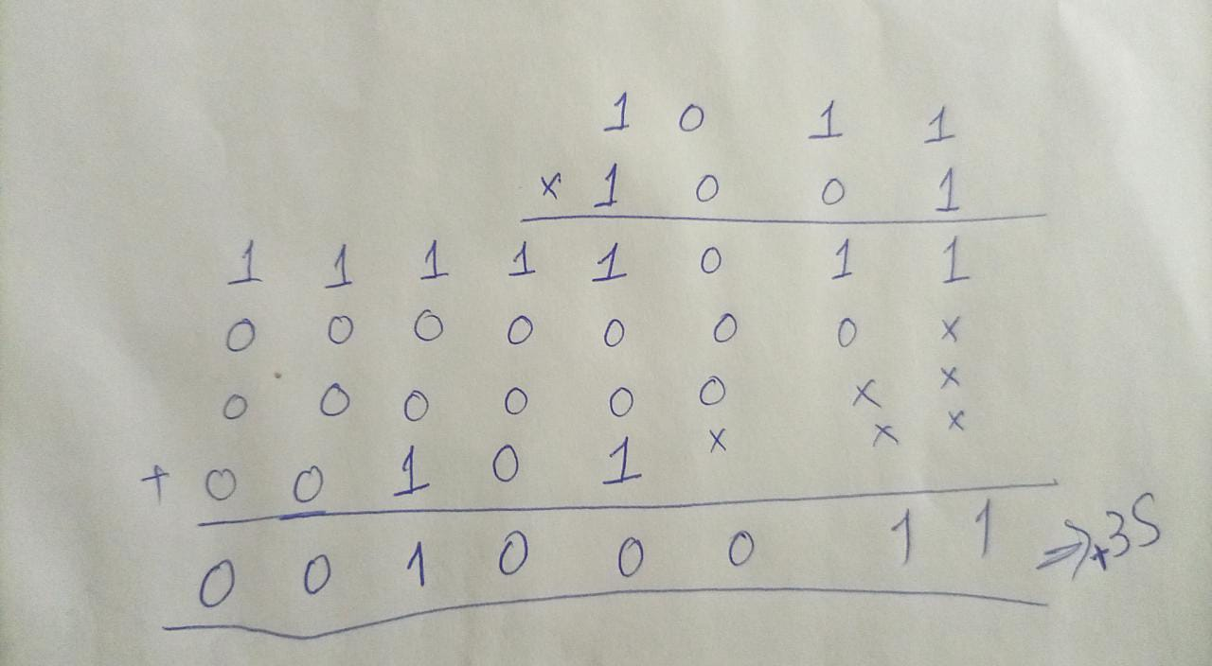
Continued..
Two’s compliment of -7 is:
→0111
AL: -5 (1011)
BL: -7 (1001)
When there is – sign in
Multiplier then two 2’s
Compliment when reach to its msb bit.

Slide 14
Best approach for signed multiplication
Booth’s algorithm
The booth algorithm is a multiplication algorithm that allows us to multiply the two signed binary integers in 2's complement, respectively. It is also used to speed up the performance of the multiplication process. It is very efficient too.

Slide 15
Binary Multiplication _ Partial Sum Approach
For every bit in Q(from right to left),
If the bit is 0, perform right shift one's on the register content.
If the bit is one, first add M with the most significant register content , then perform the right shift one.
Multiplicand(M): 1010
Multiplier(Q):0110
Formula : 2^{j+1}_2^{i}

Slide 16
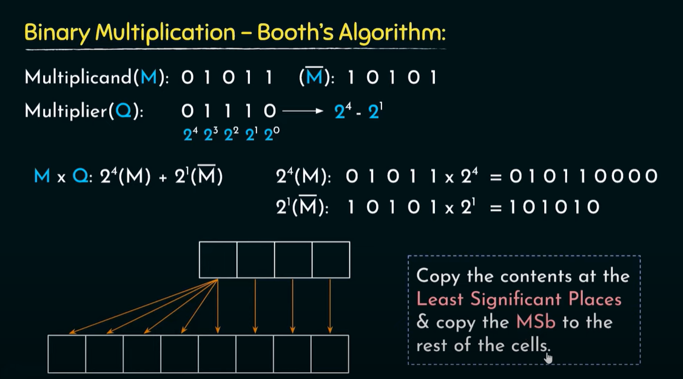

Slide 17
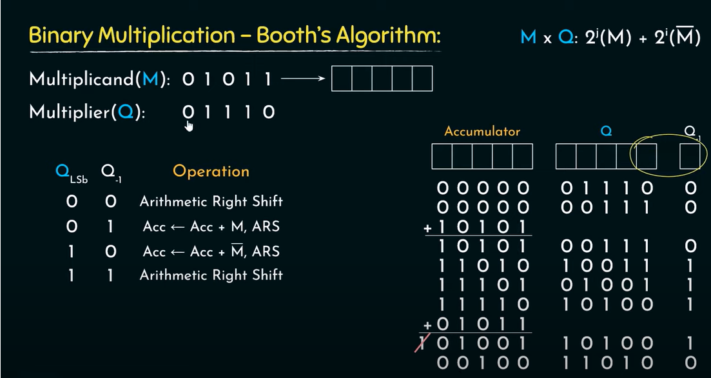

Slide 18
Advantages
Performs signed multiplications.
Perform better if –ve number are involved.
e.g 1111111111oo1 -7
Reduced number of operations.

Slide 19
disadvantages
Performance decreases ,
if the Q:1010101010……….
So it is little bit difficult or tricky to solve this question.

Slide 20
Thanks

